Slide 1


Polycystic Ovarian Syndrome Diagnostic Tool
R Shiny Web Application
Sept 2022 Cohort | Sarah Beth Powell

Slide 2

What you should know about
PCOS
(Polycystic ovary syndrome)
What is PCOS?
Affecting an estimated 5 to 6 million women in the United States, PCOS is the most common cause for infertility. The exact cause of PCOS is unknown, but research suggests that elevated levels of androgens and insulin maybe related to the condition. PCOS impacts women of all ages, even post-child bearing age.
Common Symptoms & Impacts
An estimated
$8 Billion
was spent to diagnose & treat PCOS just in the year 2020.
Excess hair growth on face & body
Irregular cycles & Infertility
Weight gain
Acne
Diabetes
Heart Disease
Reference to Endocrine Society

Slide 3
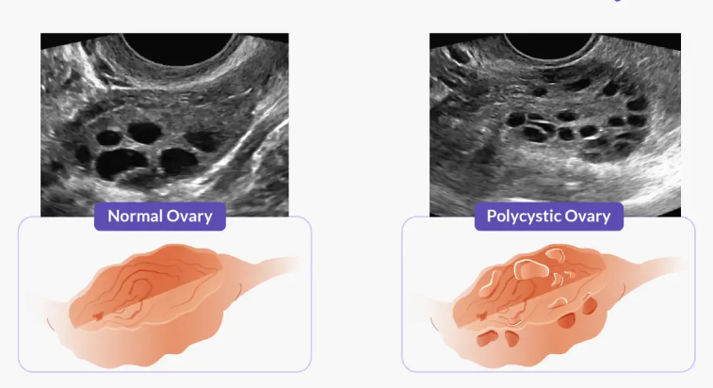
About the data
Kaggle PCOS Data was collected from 10 different hospitals across Kerala, India.
Two different files containing infertility & fertility patient data in a Comma Separated Value (CSV) file and an Excel file.
45 features included in the fertility dataset which includes various hormone levels from blood tests and symptoms of the patients.

Slide 4
Objectives
1
Create a classification model which predicts the probability of PCOS diagnosis
2
Create a tool to assist providers in diagnosing PCOS

Slide 5
Objective 1
Create a classification model.

Slide 6

Model Creation Process
Create `saturated_model`
Inspect multi-collinearity with VIF.
Create `reduced_sat_model` with VIF < 5.
Drop in Deviance
P-value
> 0.05
Consider smaller model for further analysis.
P-value
< 0.05
Consider larger model for further analysis.
1
Create a large model & nested model.
2
Conduct drop in deviance to compare models.
3
Evaluate models.

Slide 7
Model Creation Process
1
6
Create a model containing all significant features of previous models, `sig_feat_model1`.
Create a `saturated_model`.
2
Create a ‘reduced_sat_model` with features with VIF < 5.
7
Compare `sig_feat_model1` and `reduced_sat_model` using drop in deviance.
3
Compare `reduced_sat_model` with the `saturated_model` using drop in deviance.
8
Create a smaller model of only significant features of `sig_feat_model1` to create `sig_feat_model2`.
Using the ‘reduced_sat_model` as a base model, remove the most significant feature ‘Follicle_No_R` creating `no_follicle_no_r` model.
4
9
Compare `sig_feat_model2` and `sig_feat_model1` with drop in deviance.
5
Compare `reduced_sat_model` to `no_follicle_no_r models using drop in deviance.
10
Create a model using forward selection using AIC to compare as a final step.
Notes:
Step 3: P-value was 0.1614 > 0.05 meaning that the smaller model is sufficient. Include this in the analysis.
Step5: P-value was 4.877e-12 *** < 0.05 meaning that the smaller model is NOT sufficient. Back to the drawing board.
Step 7: P-value was 0.1431 which is > 0.05 meaning that the smaller model IS sufficient.
Step 9: P-value was 0.05302 which is > 0.05 meaning that the smaller model IS sufficient.

Slide 8
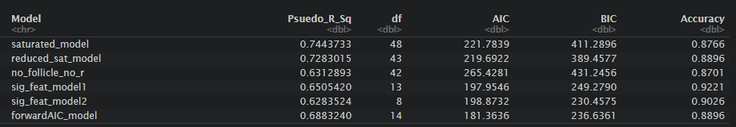
Model Evaluation
Sig_feat_model2 which uses 8 features is the model I chose to create the Shiny Web Application due to the simplicity while giving satisfactory metrics
Sig_feat_model1 or forwardAIC_model would be a great choice for creating the next iteration of the Shiny Web Application
Notes:
Step 3: P-value was 0.1614 > 0.05 meaning that the smaller model is sufficient. Include this in the analysis.
Step5: P-value was 4.877e-12 *** < 0.05 meaning that the smaller model is NOT sufficient. Back to the drawing board.
Step 7: P-value was 0.1431 which is > 0.05 meaning that the smaller model IS sufficient.
Step 9: P-value was 0.05302 which is > 0.05 meaning that the smaller model IS sufficient.

Slide 9
Objective 2
Create a diagnostic tool for providers.

Slide 10

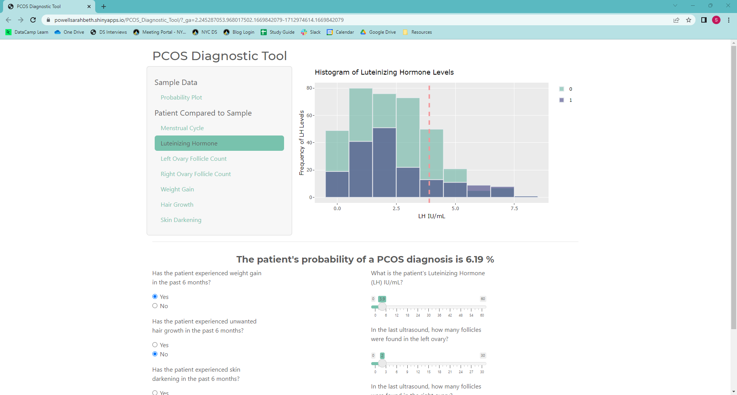
R shiny app

Slide 11
Potential Enhancements
Modeling
Bootstrap to increase sample size to improve model performance
Try other classifier models such as Support Vector Classifier or K-Neighbors
Web Application
Create more inputs for the higher performance model
Overlay prediction on the Sigmoid Function visualization
Future Use
Enhance with more data to aid in research opportunities for heath research organizations
Use as a patient advocate tool to aid in their healthcare

